Slide 1
Data science digital portfolio
STUDENTS NAME :S.SATHYA PRIYA
REGISTER AND NMID:24131131805222008/asanm11324131131805222007
DEPARTMENT:BSC.DATA SCIENCE
COLLEGE: VALLALAR ARTS AND SCIENCE COLLEGE, ANNAMALAI UNIVERSITY

Slide 2
Agenda
Introduction
History & evolution
Components of data science
Data science lifestyles
Tools and technologies
Application of data science
Advantage
Challenge
Future trends
Conclusion

Slide 3
Introduction
Data Science = combination of statistics, mathematics, programming & domain knowledge. Helps extract insights from structured & unstructured data. Plays a vital role in decision-making.

Slide 4
History & evolution
1960s: Term “Data Science” first appeared. 1990s: Rise of databases & statistical methods. 2000s: Big Data & machine learning advancements. Today: AI-powered data science shaping industries.

Slide 5
Components of data science
Data Collection Data Cleaning & Preparation Data Analysis Machine Learning / AI Data Visualization Communication of results

Slide 6
Data science lifestyles
1.Problem Definition 2. Data Collection 3. Data Preparation 4. Model Building 5. Model Evaluation 6. Deployment & Monitoring

Slide 7
Tools and technologies
Programming: Python, R, SQL Frameworks: TensorFlow, PyTorch, Scikit-learn Visualization: Tableau, Power BI, Matplotlib Databases: SQL, MongoDB Platforms: Jupyter Notebook, Google Colab

Slide 8
Application of data science
Healthcare (disease detection, drug discovery) Finance (fraud detection, stock predictions) Business (customer insights, recommendation systems) Transportation (autonomous vehicles) Social Media (content personalization)

Slide 9
Advantage
Better decision-making Predictive analysis & forecasting Automation of tasks Improves efficiency & accuracy

Slide 10
Challenge
Data privacy & security issues Lack of skilled professionals Data quality & availability High computational cost

Slide 11
Future trends
AI-driven data science Edge & cloud computing Explainable AI (XAI) Data ethics & governance Automation in data workflows

Slide 12
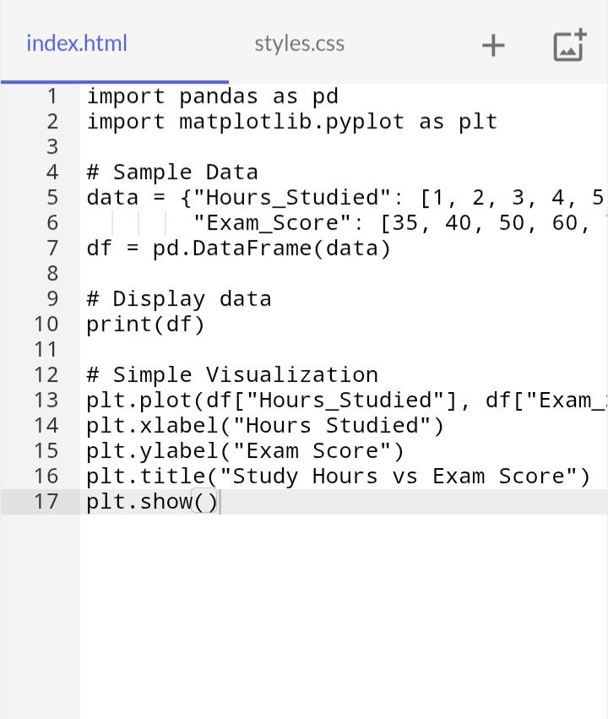

Slide 13
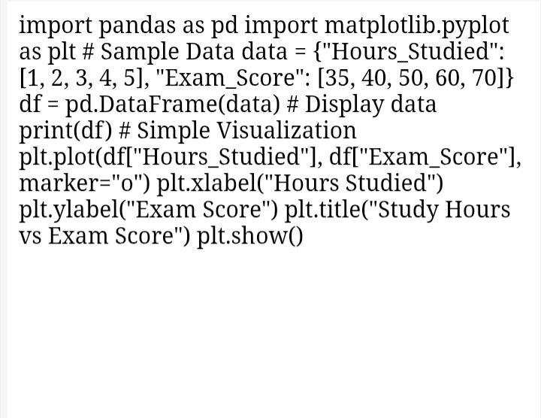

Slide 14
Conclusion
Data Science is transforming industries. Powerful in solving real-world problems. Future depends on AI, ML, and ethical data use.

